Slide 1

Benefits of Resolving Commercial Disputes Through Mediation and Recent Trends in Sector-Specific Mediation
March 8, 2022
Nina Mocheva
Senior Financial Sector Specialist
Finance, Competitiveness and Innovation Global Practice

Slide 2
Introduction
Benefits of Mediation
Trends in Use of Commercial Mediation
Use of Commercial Mediation in Finance: Current Trends, Opportunities and Limitations

Slide 3
Introduction
“Disputes are part of life, and we all experience them sometimes. They give us an opportunity to solve problems and to improve relationships, but they carry a risk of being destructive if not managed well”
- Mediation Series: Mediation Essentials (Washington, DC: IFC/World Bank Group, 2016)

Slide 4
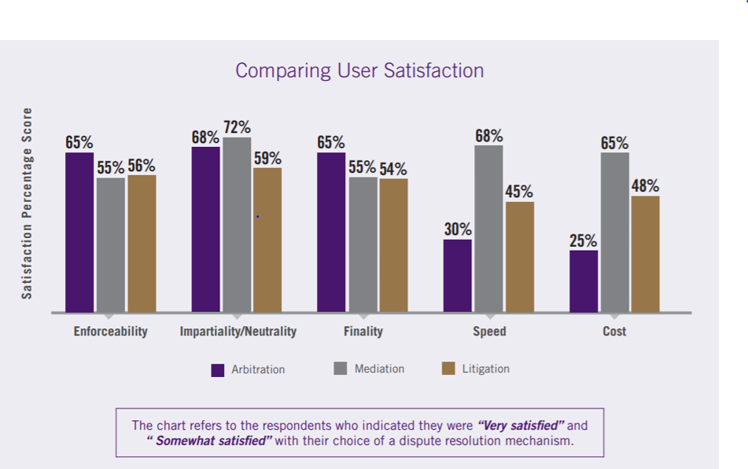
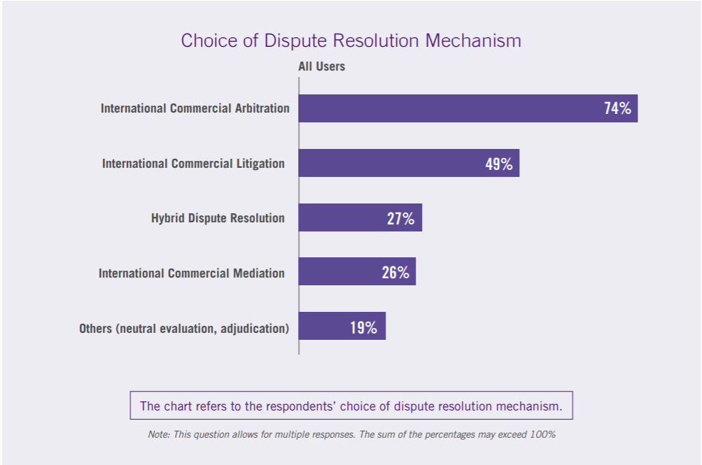
Benefits of Mediation: SIDRA Survey (2020)
Singapore International Dispute Resolution Academy's International Dispute Resolution Survey (2020)

Slide 5
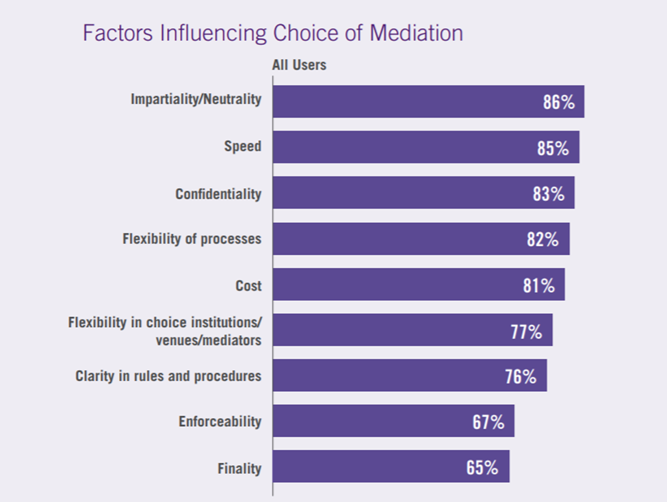
Benefits of Mediation: SIDRA Survey (2020)
Singapore International Dispute Resolution Academy's International Dispute Resolution Survey (2020)

Slide 6
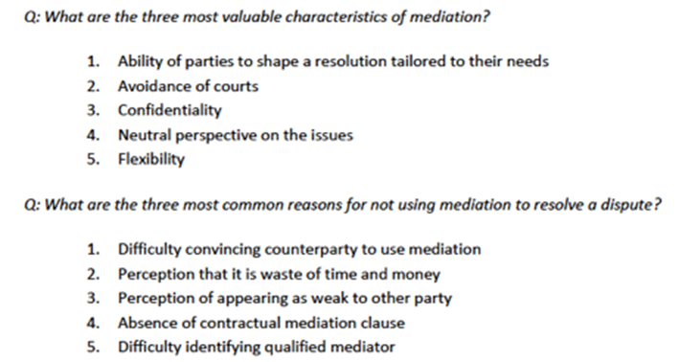
Benefits of Mediation: CPR-CEDR Study (2018/2019)
Source: Report by International Institute for Conflict Prevention and Resolution (“CPR”) and the Centre for Effective Dispute Resolution (“CEDR”) (2018/2019)

Slide 7
Trends in Use of Commercial Mediation
Greater harmonization of mediation regulation (UNCITRAL; Singapore Convention; EU Mediation Directive)
Broader user across industries (particularly Finance and Construction)
Increased specialization (co-mediation including process experts + industry experts, specialized rules)
Increased use through hybrid processes (in combination with arbitration)
Emergence of ODR

Slide 8
Use of Mediation in Finance: Current Trends
Demand for mediation in financial disputes is picking up (albeit slowly) (ICC Survey; PWC Survey)
1997 Asian Financial Crisis, 2008 Global Financial Crisis accelerated the use of ADR in financial disputes (creation of OCW frameworks, use of mediation in bankruptcy)
A number of specialized dispute resolution service providers cater to finance and banking (e.g. ISDA, P.R.I.M.E. Finance in The Hague, FDRC in Hong Kong, FINRA in the U.S., CIETAC in China, AAA in the U.S., financial consumer ombuds globally, etc.)

Slide 9
Use of Mediation in Finance: Opportunities
  “One size may not fit all, ” but mediation offers unique benefits and opportunities for resolving financial disputes:
Confidentiality (protection of sensitive financial information, avoiding reputational damage, incentivizing early resolution of problems)
Relationship preservation (long-term contracts)
Independence, impartiality and specialization (cross-border financial transactions, complex disputes)
Multi-party context (bringing all the relevant parties to the negotiation table)
Flexibility (opportunities to tailor the procedure depending on the nature of the dispute)

Slide 10
Use of Mediation in Finance: Limitations
Regulatory obstacles (third party rights and avoidance rules in insolvency laws; public interest protections)
Insufficient awareness and confidence in mediation, lack of precedent-setting
Perception of bias in industry-initiated fora

Slide 11


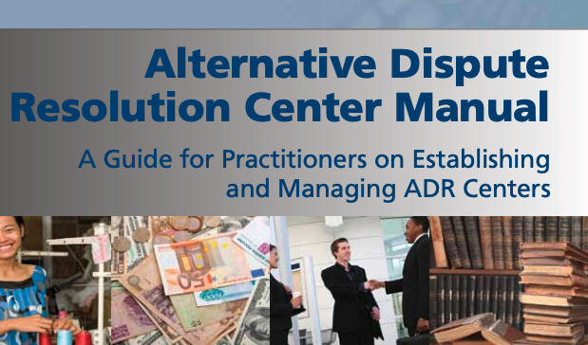
WBG Materials on ADR
Mediation Series (3 guides): Mediation Essentials, Integrated Conflict Management Design Workbook, and Making Mediation Law.
Alternative Dispute Resolution Guidelines
Alternative Dispute Resolution Center Manual

Slide 12
Questions?
Thank you!
Contact: nmocheva@ifc.org

Slide 13
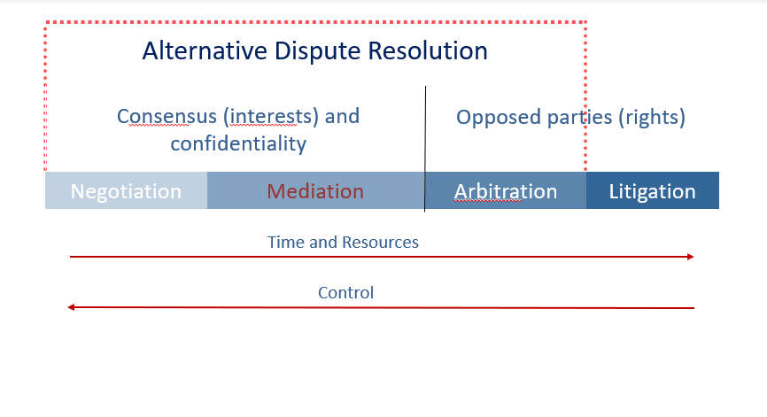
EXTRA SLIDE: Dispute Resolution Continuum
Mediation in dispute resolution continuum: more control, less time and resources

Slide 14
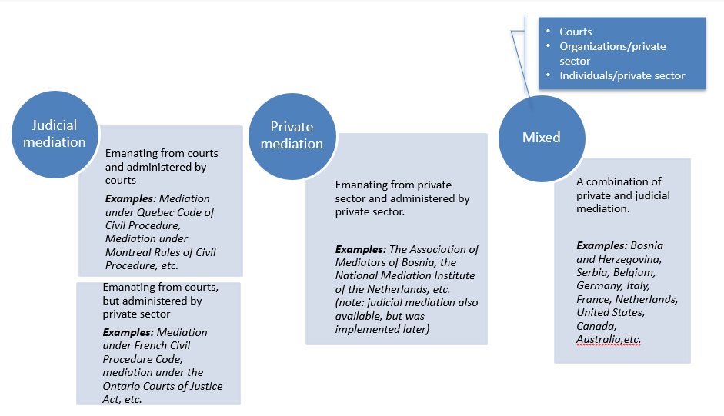
EXTRA SLIDE: Access to Mediation Services
3 types of Mediation from the point of access:

